Slide 1

Homeownership Trends & Impact
Made by Eugene, Pawel, Brice, Rommell, Israel, Victor

Slide 2
Table Of Content
Introduction
Context of the problem
Objectives and questions
Data Source
Time and Place
Data Set Overview
Data Parameters
Features Engineering
Visualization
Chanllenge
reference
Notes:
Eugene

Slide 3

Introduction
The term Homeownership refers to the act of owning home property, whether that is a house or apartment.
The problem that influences the trend of Homeownership is the affordability of those property.
Notes:
Israel

Slide 4
The context of the Problem
Housing affordability refers to the ability of individuals or families to comfortably purchase or maintain a home.
Over the years, Housing costs increased. This in turn leaves less room for other necessities
Notes:
Eugene

Slide 5

Objectives & data Questions
Objectives:
Identify the factors of homeownership
Analyze demographics disparities
Evaluate the evolution of the Problem
Questions:
How can people afford a house depending on their financial status?
What is the trend in housing affordability over time?
What are the factors that determine the affordability of a house?
How did the crisis affect the different demographic groups?
Notes:
Victor

Slide 6

Data Source
The American Community Survey (ACS) is a data center created since the year 2005 and managed by the U.S. Bureau Census
For the case of the project, the team will be using two years(2017 & 2022) to process a comparative study.
Notes:
Victor

Slide 7

Time & Place
The project examines housing trends in 2017 and 2022, highlighting the effects of the 2008 market crash and a 19% rise in home sales after COVID-19 in 2021.
2022 and 2017 were selected to compare a 5-year gap, with 2022 offering the latest data.
California, with a 69.7% diversity index, is the second most racially diverse state in the U.S.
Notes:
Brice

Slide 8
Data set overview
The original data set has the following:
The reduced data set has:
2017 | 230 features | 157,735 instances
2022 | 176 features | 167,264 instances
2017 | 6 features | 50,721 instances
2022 | 6 features | 57,207 instances
Notes:
Eugene

Slide 9
Data parameters
For this study, the main factors that helped us observe the crisis were the Food Stamp (FS) features, the income of the household, and both the rent and mortgage of the property.
Additionally, the feature that held secondary importance in the project was the race features to determine the different demographic groups.
Notes:
Eugene

Slide 10

Features Engineering
To clean our data, we had to create some new features such as:
Income Groups (grouping annual salaries)
Percent Spent (on monthly house costs)
Multiracial (combination of the Other races & Two race features)
Notes:
Rommell

Slide 11
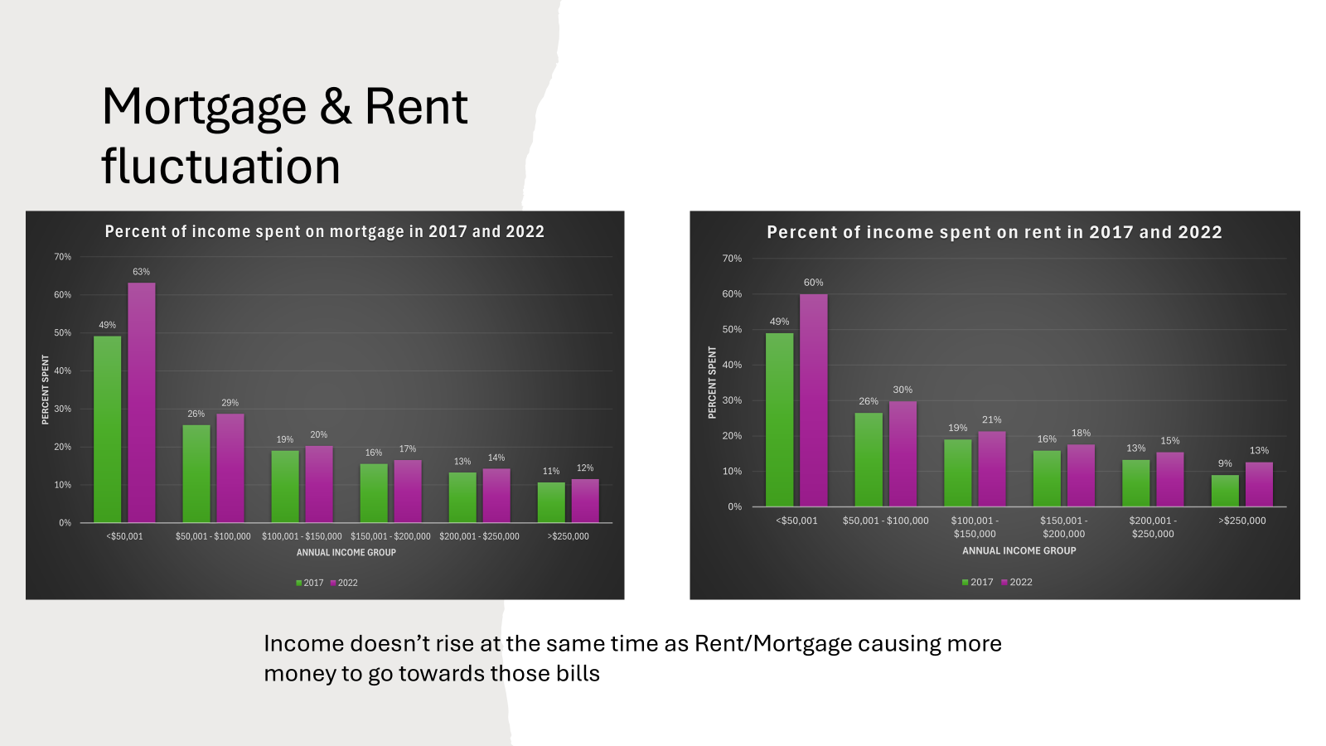
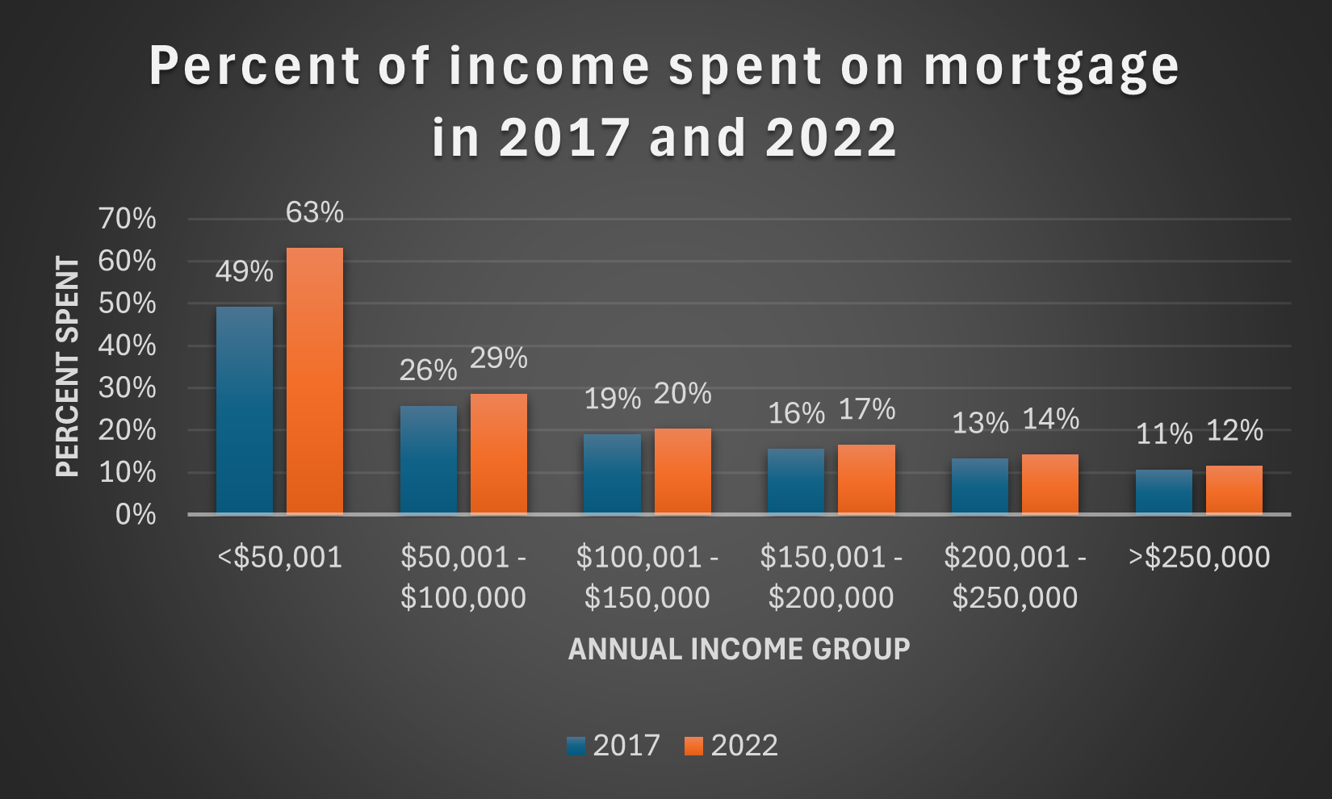
Findings & impacts
During The years 2017 and 2022, we observed an average increase of 3.5 % of the income spent on mortgages by the population of California.
Notes:
Rommell

Slide 12
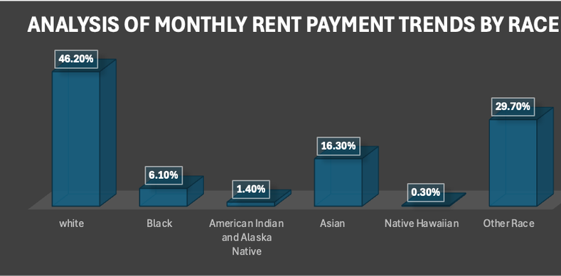
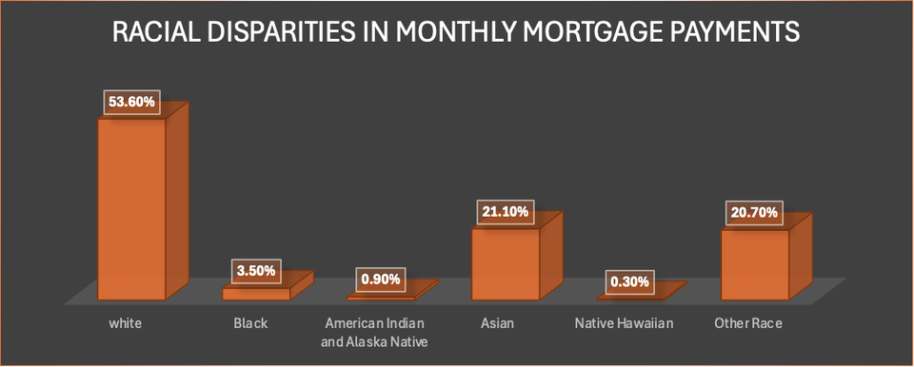
Racial Disparities in Affordability's Crisis
Only 4.7% and 7.8% of the population cannot respectively afford to pay their mortgage and rent. That minority group cannot even afford to pay for a decent house
Notes:
Brice

Slide 13
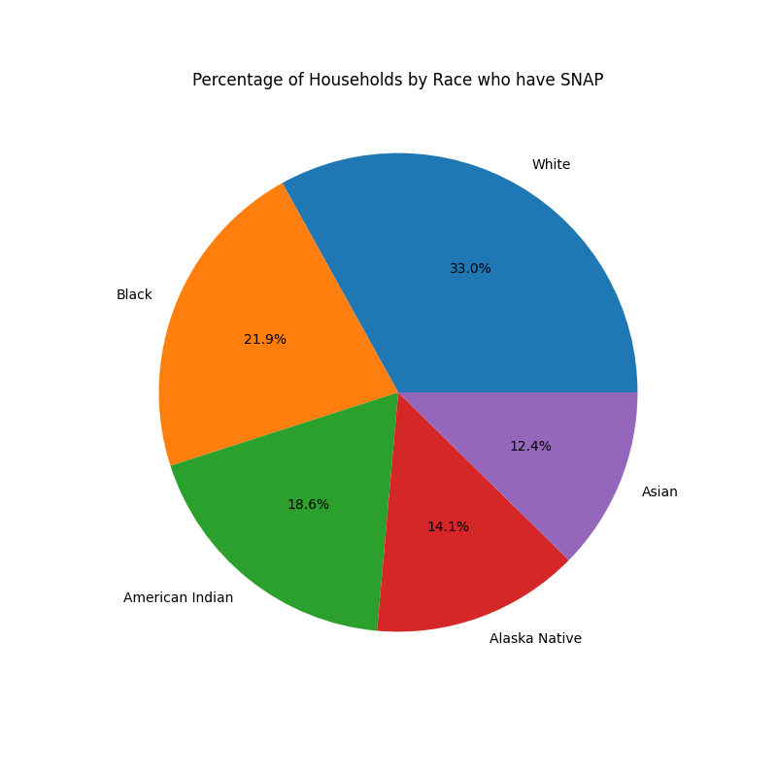
Food Stamp Group distribution
More than 65% of the population suffers from low-income situations.
Notes:
Israel

Slide 14
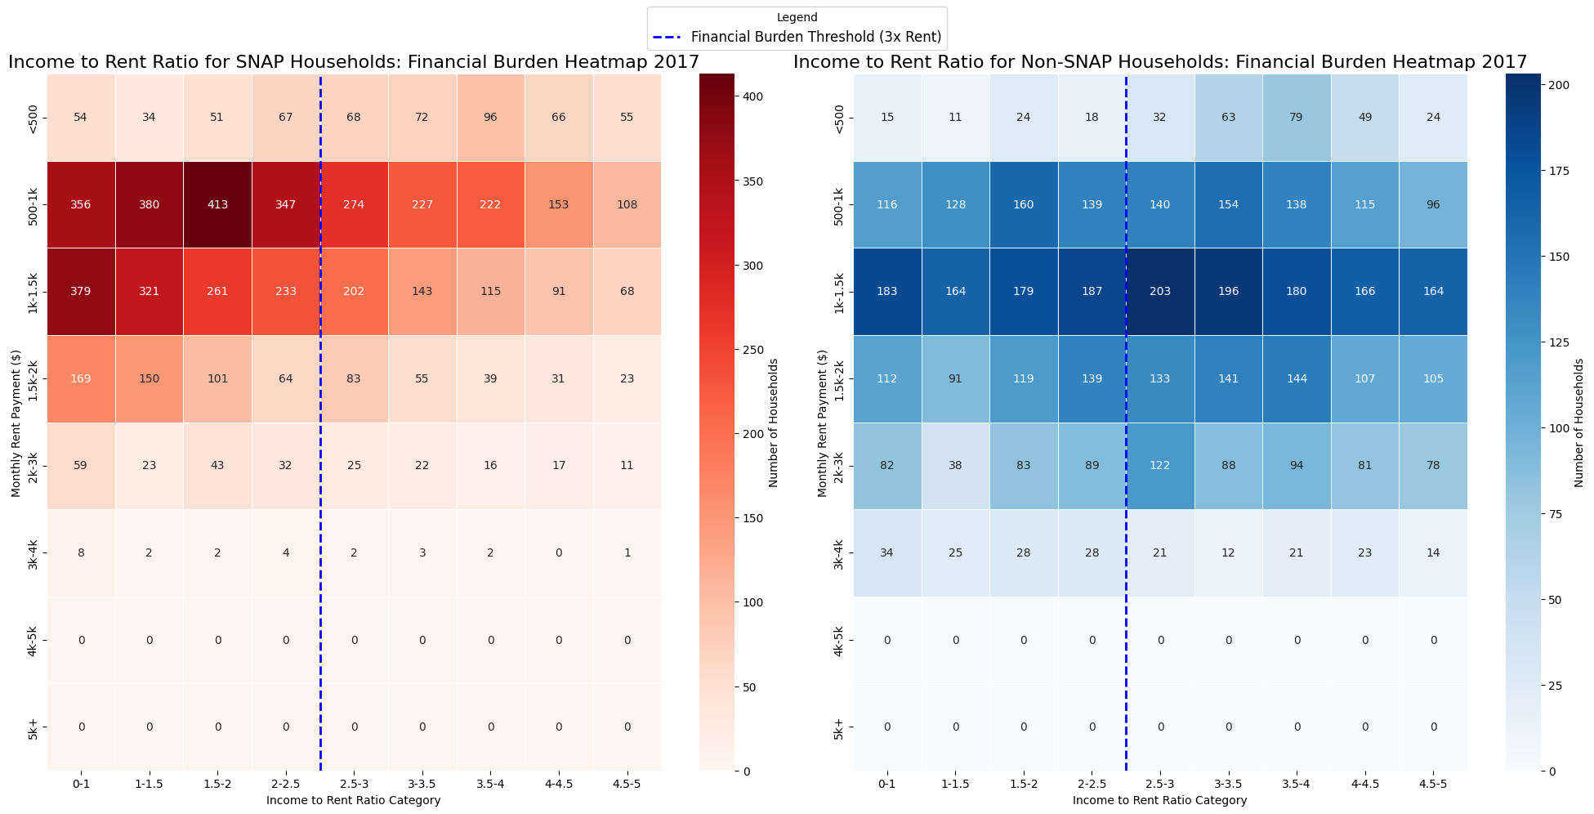
Notes:
Pawel

Slide 15
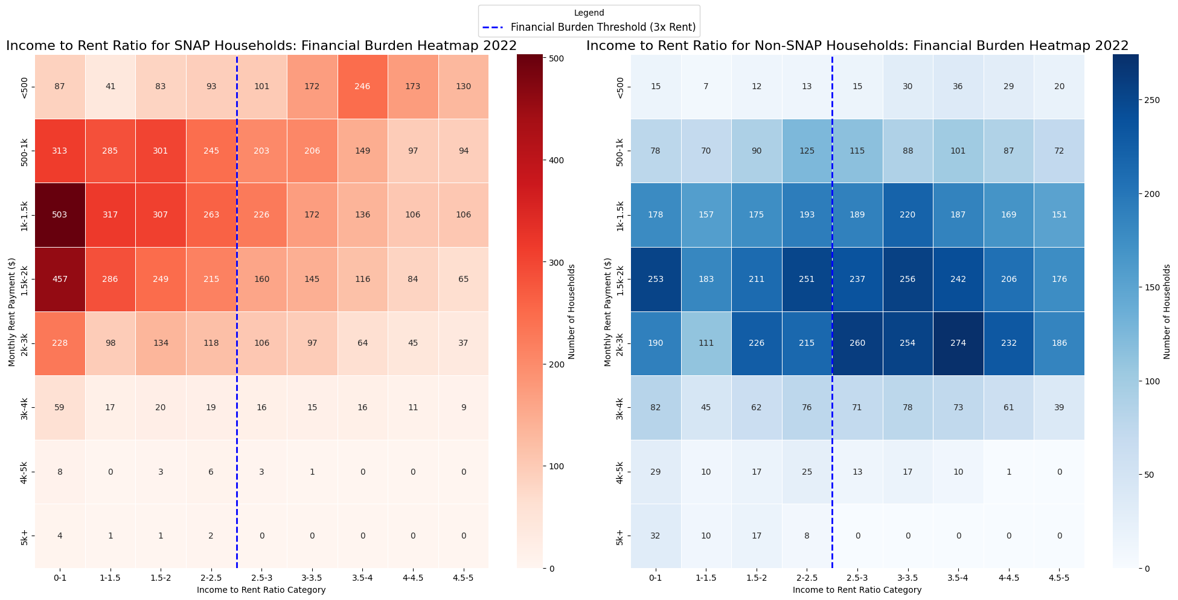
Notes:
Pawel

Slide 16
CalWORKs Housing Support Program (HSP)
Proposed Solution Budget Allocation for HSP:
Allocate a portion of the budget to businesses to subsidize a percentage of wages for employees facing housing instability
Aim to promote economic stability and prevent homelessness
Eligibility:
WIC Section 11330.5(a) HSP eligibility includes:
Families in CalWORKs at risk of homelessness
Recipients without an eviction notice
Individuals for whom housing instability is a barrier to self-sufficiency or child well-being
Budget Act of 2021 (SB 129) appropriated a total of $285 million for the Housing Stability Program (HSP), including:
Annual Appropriation: $95 million
One-Time Appropriation: $190 million
Our simulation of wage subsidize: from the program to employers would cost around $17 million
Notes:
pawel

Slide 17
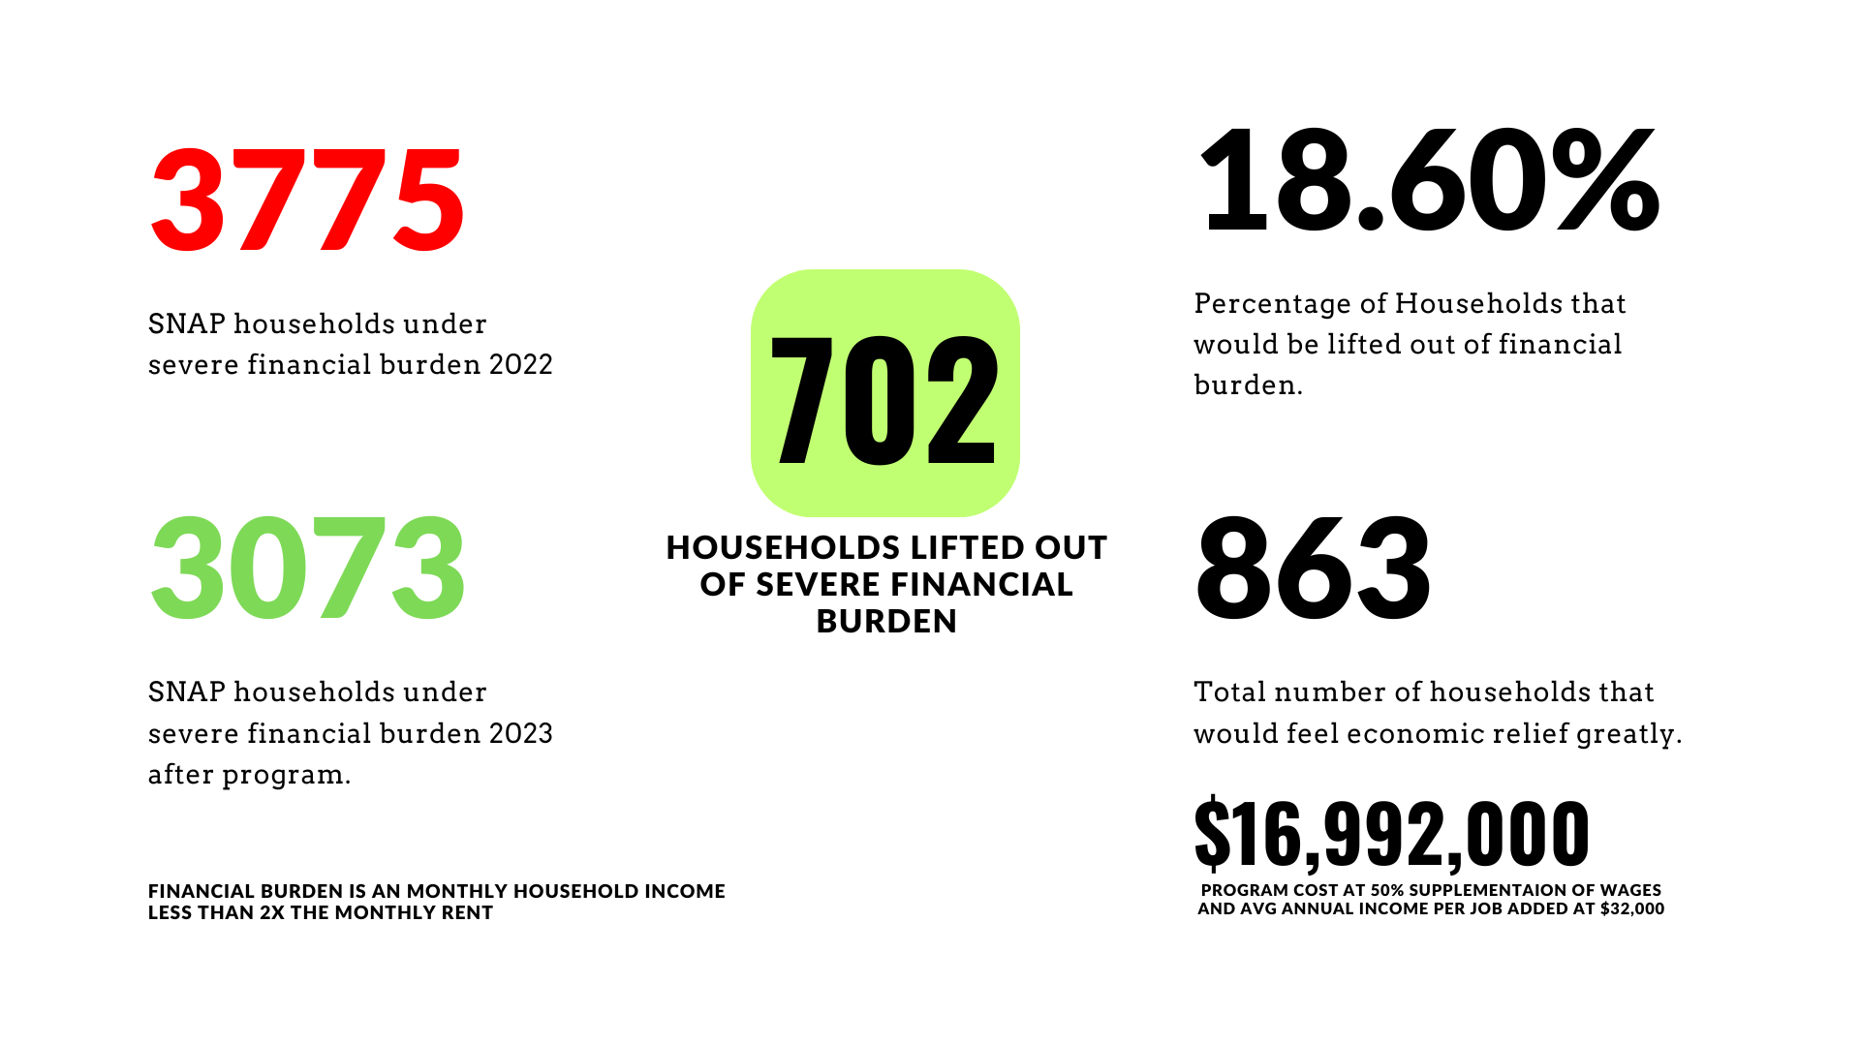
Notes:
pawel

Slide 18
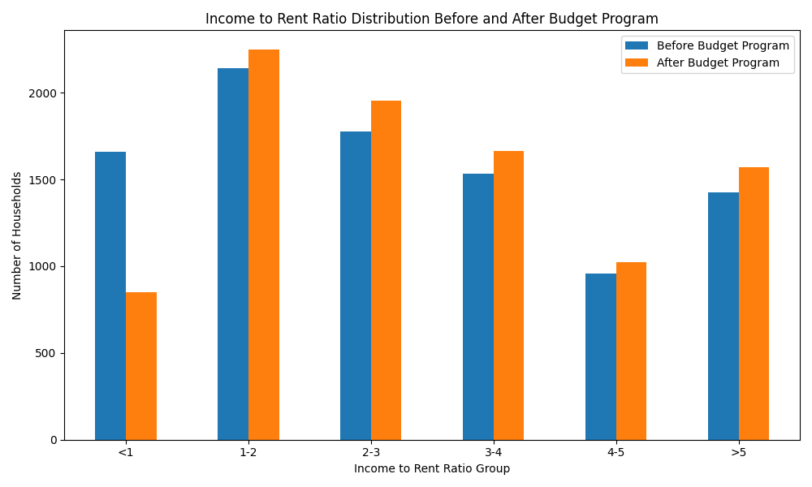

Slide 19
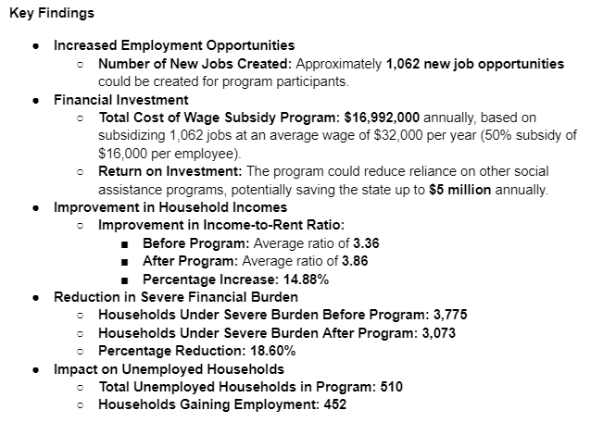
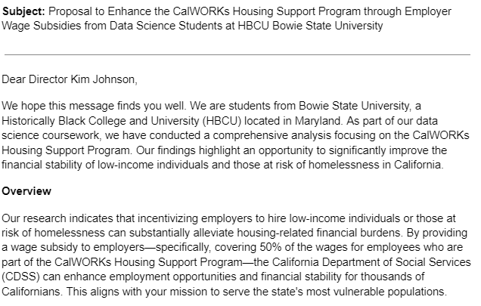
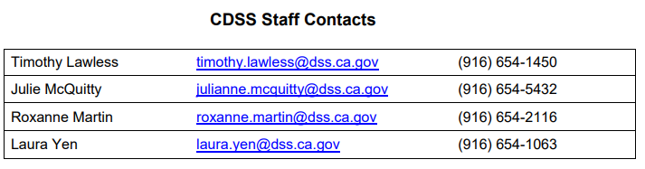

Proposal and contact with policy makers
Notes:
Pawel

Slide 20

Challenges
Due to the missing time, we were not able to implement machine learning to try to predict the next year.
Additionally, to showcase a little more about the affordability crisis impact we wanted to include additional factors such as water, electricity status, healthcare, etc.
Notes:
Eugene

Slide 21
references
Hubbard, K. (2021, August 19). The 10 States With the Most Racial Diversity. Retrieved from U.S. News: https://www.usnews.com/news/best-states/slideshows/the-10-most-racially-diverse-states-in-the-us?slide=10
Why house prices surged as the COVID-19 pandemic took hold. (2021, December 21). Retrieved from Federal reserve BAnk of Dallas: https://www.dallasfed.org/research/economics/2021/1228

